Slide 1
SOLAR SOLUTION MANUFACTURER
March 2023
LESSO NEW ENERGY DEVELOPMENT PRIVATE LIMITED
One Raffles Quay, North Tower, #19-03, 48583 Singapore

Slide 2


This presentation
LESSO Company Overview
Solar Solution Maufacturer
Shining Projects proceed by LESSO
Building a Solar-Powered World

Slide 3
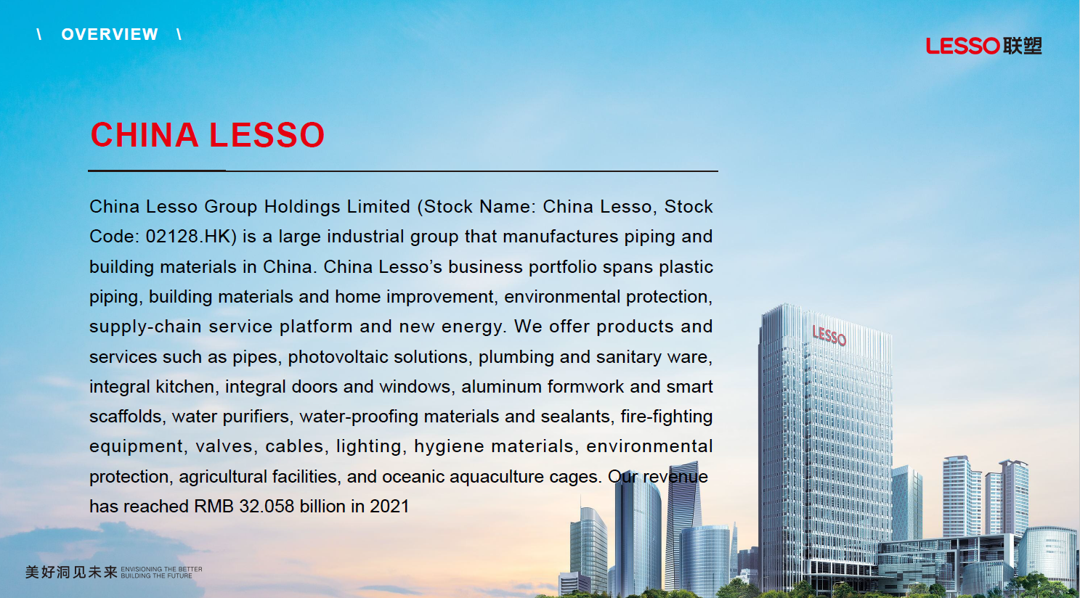



Slide 4
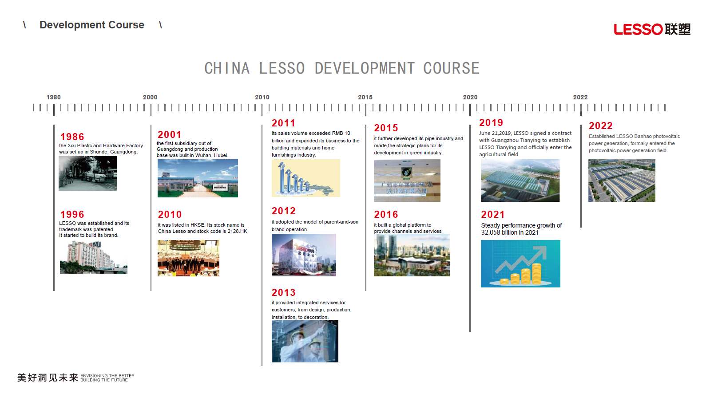




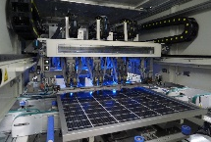

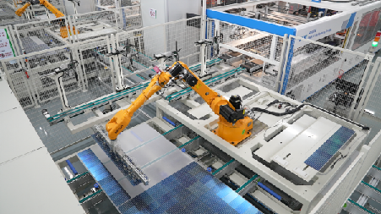
Heritage and Momentum since 1986
Steady growth 4.5 USD billion revenue in 2021
Lesso Wusha production base put into production, annual output of 6.4GW
Set up Lesso Banhao New Energy Group
Construct Lesso’s first Industry & Commercial Distributed PV Project.

Slide 5
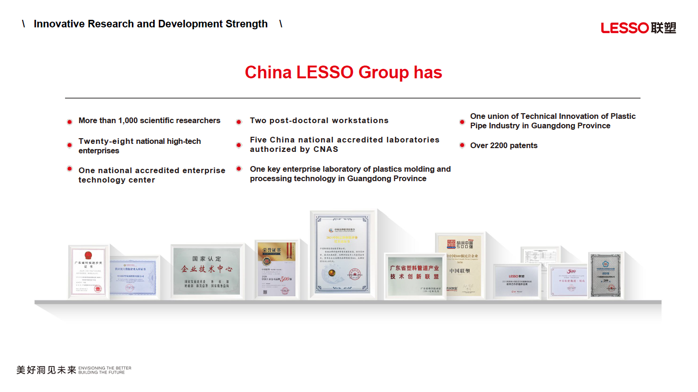
Research Achivement

Slide 6
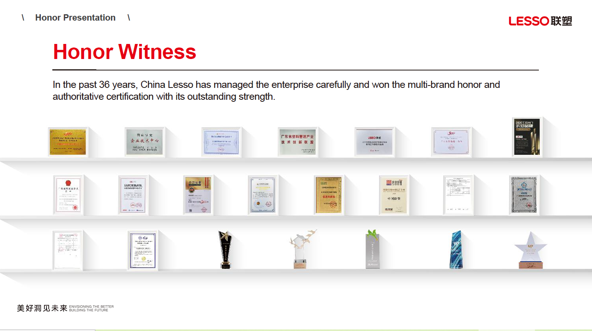

Awards Received
37

Slide 7
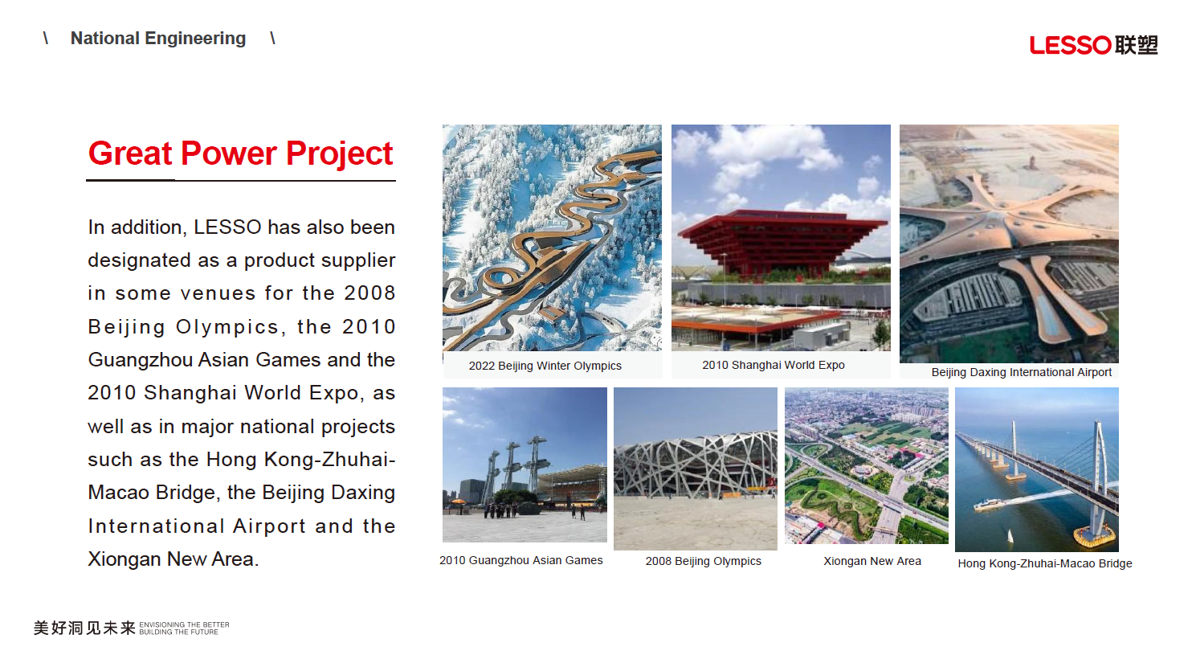

Our Track Record at National Level in China
National Projects Supplier

Slide 8
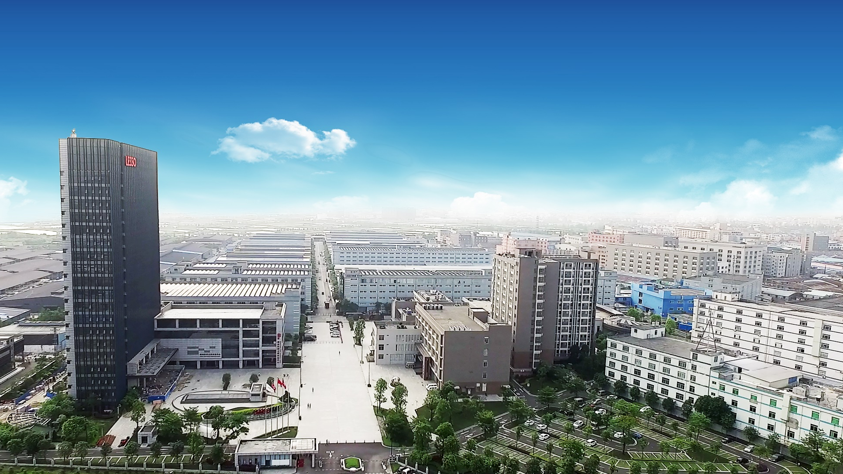
The Global Headquarter Complex for China Lesso Group in China

Slide 9

LESSO Solar Scaled Up Rapidly
4.5
$ Bn
37
Years
7GW
Capacity
18
Months
*
150k
㎡ factory area
16
Countries
*
LESSO Solar is the flagship division of LESSO Group, Hong Kong-listed (2128.HK) manufacturer of building materials with 37 years of heritage and annual revenue of over USD4.5 billion.
LESSO Solar specializes in manufacturing solar panels, inverters, and energy storage systems, and providing solar-energy solutions, covering various clients' needs: residential, commercial, industrial and utility scale.
*7GW annual production capacity established in the first 18 months since LESSO Solar’s establishment
*where we have sales office in February 2023

Slide 10
Solar Business’s Rapid Development
Why LESSO can have 7GW’s annual production capacity within 18 months?
Long term sourcing of machinery and equipment
LESSO has 37 years experience in building materials manufacturing , which facilitate the factories set-up with competitive price procurement of machinery from existing China and overseas suppliers.
Strategic supply partnership for raw materials
LESSO has multiple raw material suppliers across China, and has strategic partnership with major solar upstream suppliers.
Existing land ownership
In China and worldwide
LESSO has 30 land parcels in China and worlwide, such as South East Asia and the United States, which facilitate our own factory and local office establishment.
Existing talent
In China and worldwide
LESSO has a strong workforce across 12 provinces in China and 16 countries worldwide, enabling rapid deployment of resources and human capital to achieve its latest aspirations in green energy and solar.
Strong sales network in China and global markets
LESSO has over 2000 distributors in China and 20 000 employees including a sales team of 55 person in 16 countries internationally.
Global Banking
Network
LESSO has long term cooperation with major Banks across the globe, such as HSBC, DBS, Standard Chartered, UBS that allows us to establish and operate in existing and new countries swiftly.

Slide 11
Solar Business Strength
R&D Advantages
Advanced labs and automatic production with world-class
digitization technology
Production Capacities
7GW solar PV modules production capacities
Solar Solution Manufacturer
Effectively integrated upstream manufacturing : solar cells, PV panels, solar PV systems, PV roof tiles, inverters and energy storage batteries.

Slide 12
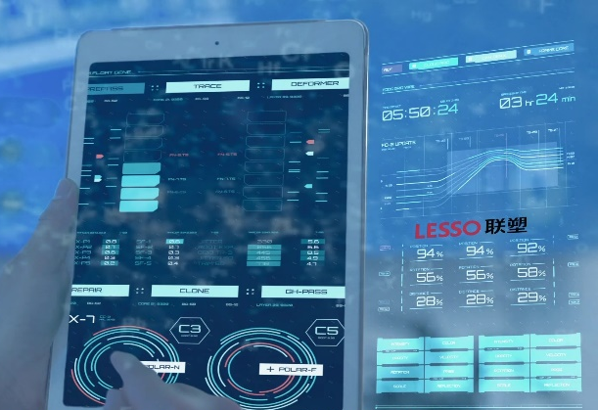
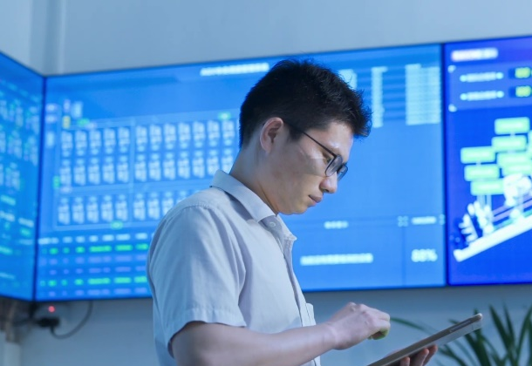
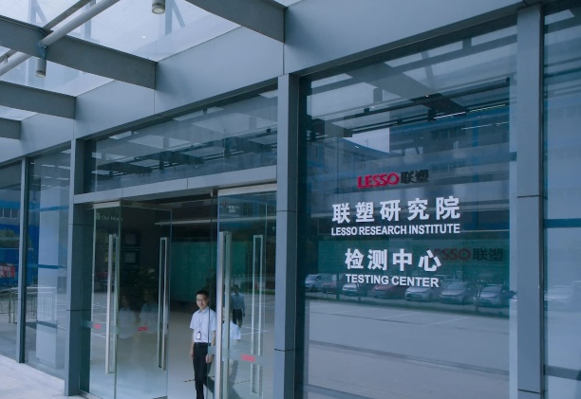
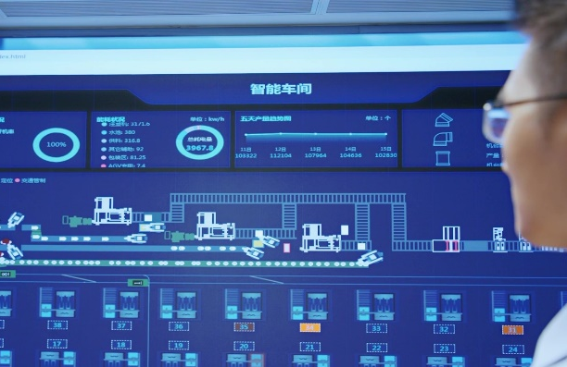
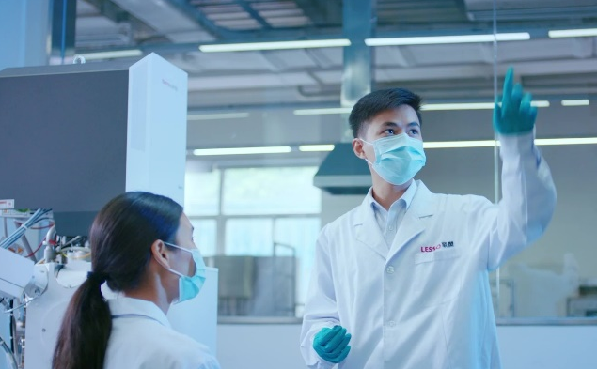
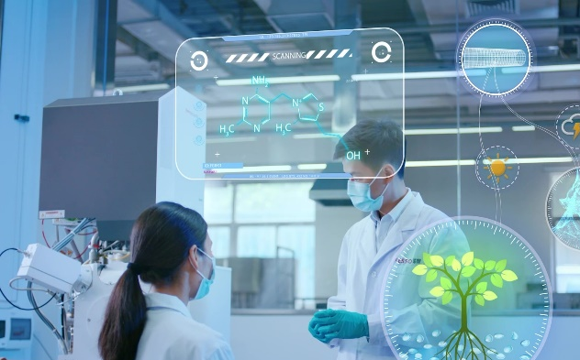
R&D and Quality Center
ADVANCED LABS WITH WORLD-CLASS TECHNOLOGY

Slide 13


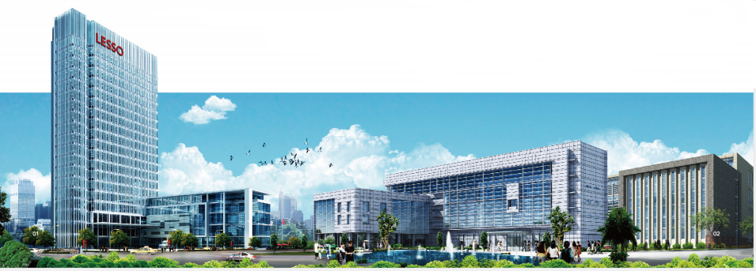
Solar Factories
Jiangmen Heshan Gonghe Industrial Park Production Factory
Annual output of 6GW solar cells, and 6GW PV Modules and supporting accessories, will be put into production in 2023, creating a vertical integrated clean energy industrial park.
Chongkou Factory
Shunde,China
500MW in solar modules
Wusha Factory
Shunde, China
6.4GW in solar modules
Gonghe Factory
Jiangmen, China
6GW in solar cells
6GW in solar modules
Semarang Industrial Park
Semarang, Indonesia
2GW in solar modules

Slide 14
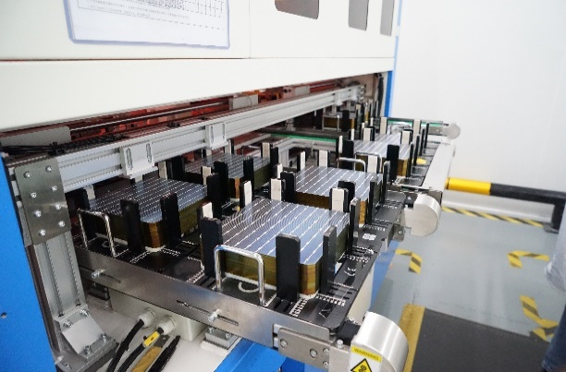
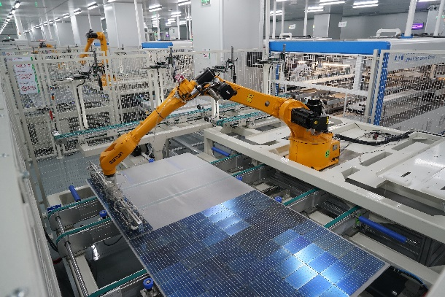
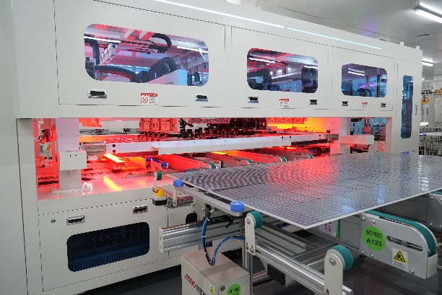
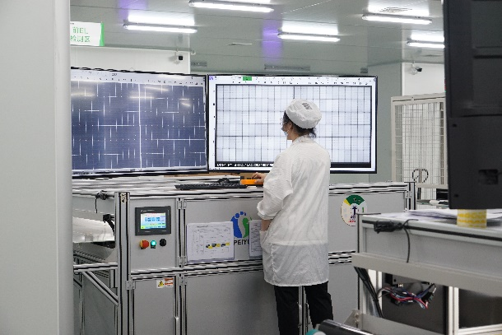

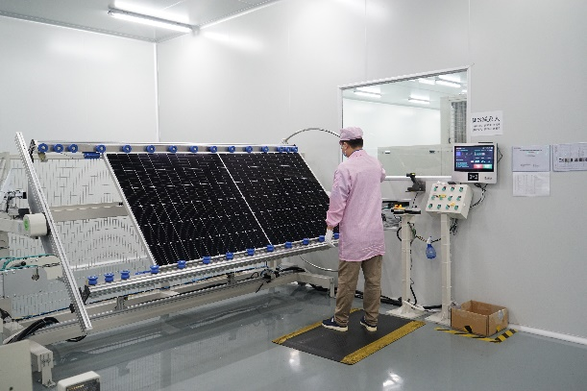
Existing Production Facilities
AUTOMATION, DIGITIZATION, DUST-FREE AND 24-HOUR OPERATION

Slide 15
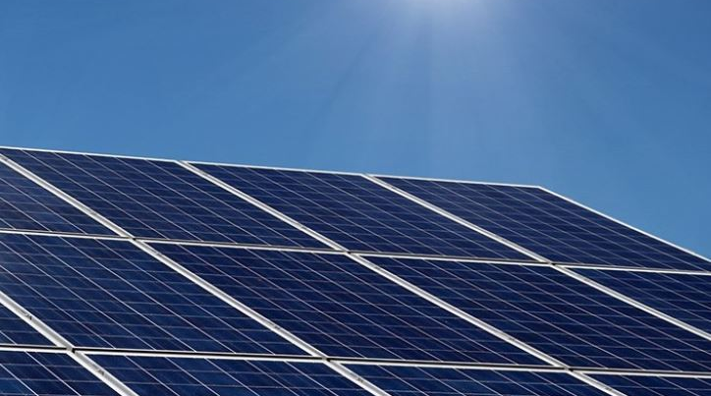
Integrated Solar Solutions Provider

Slide 16
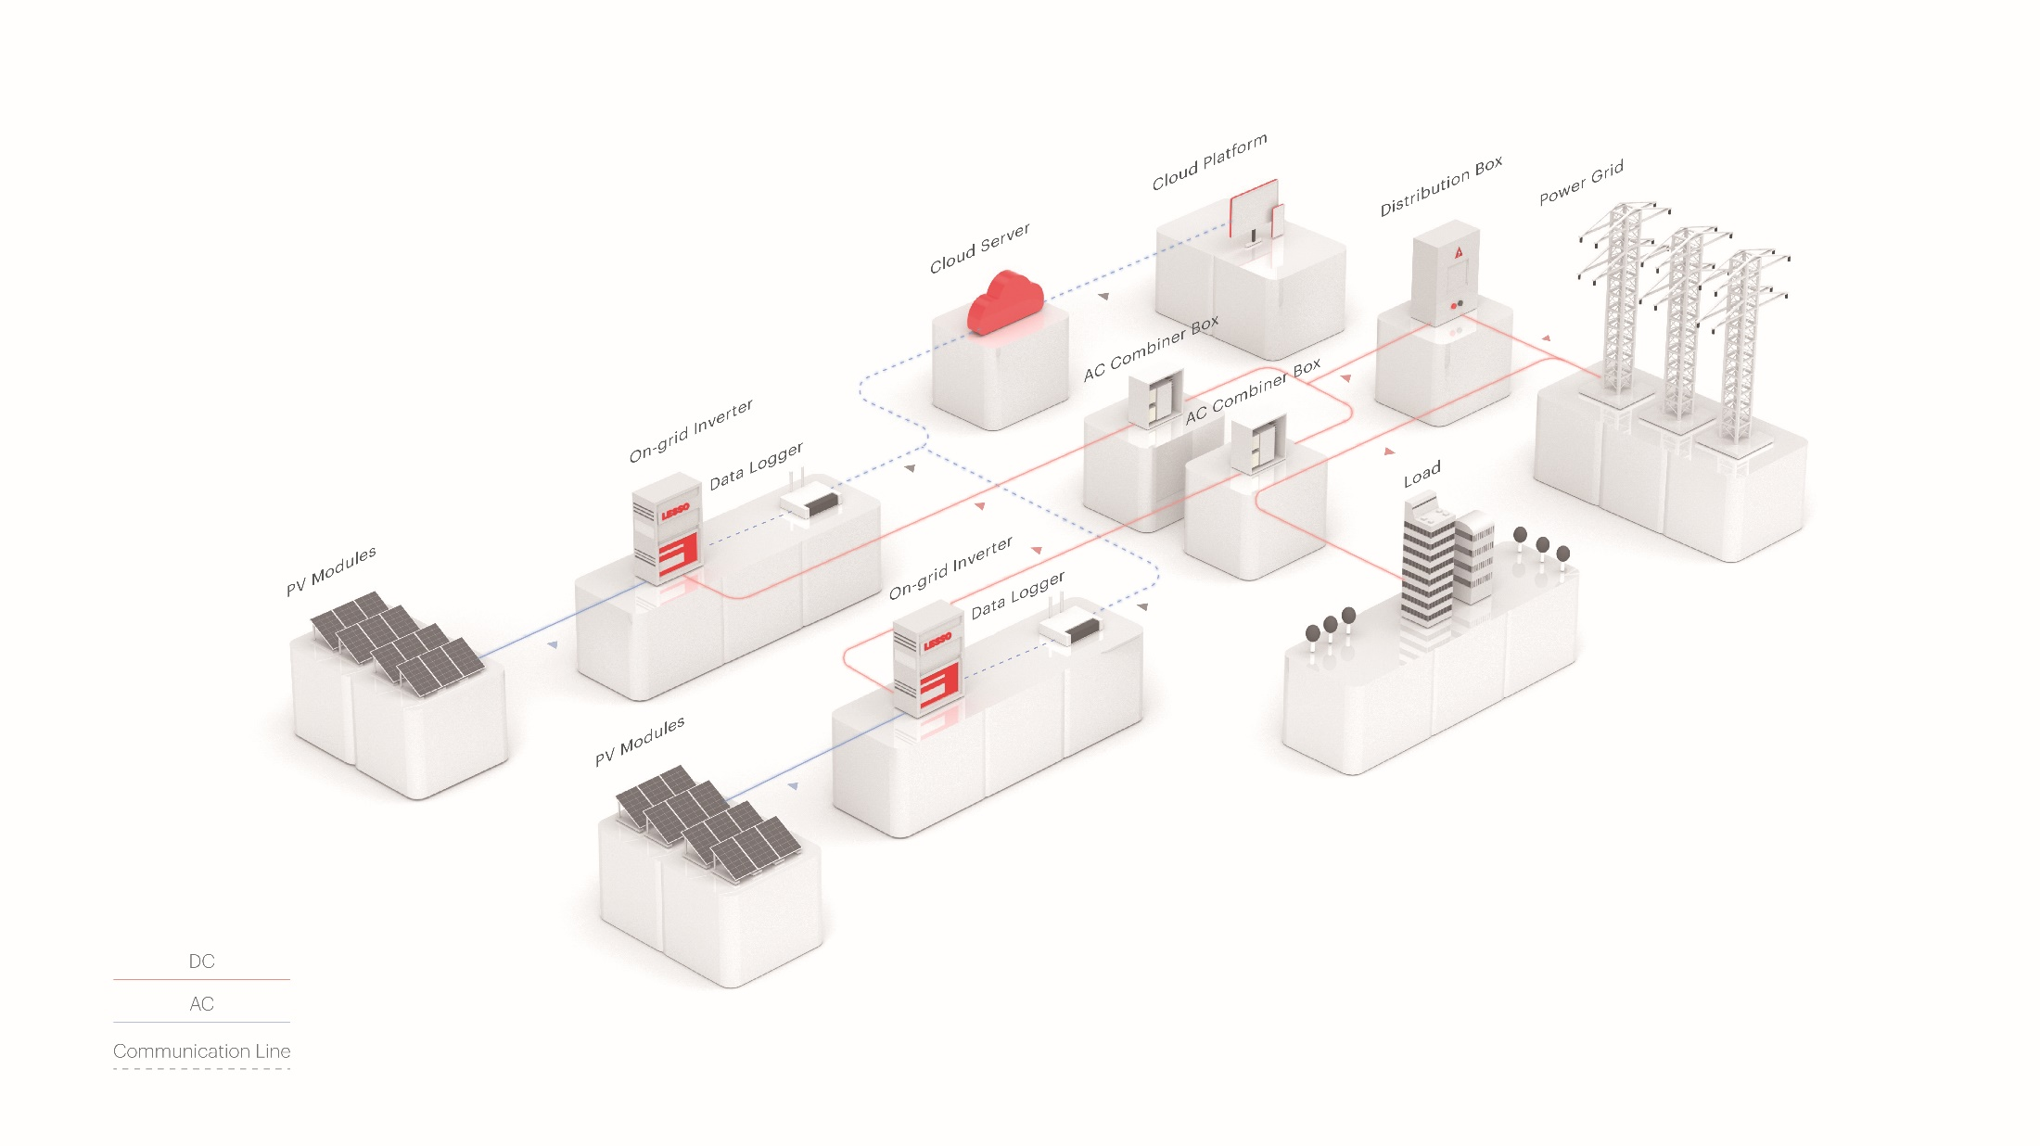
Industrial and commercial
distributed photovoltaic grid-connected power generation system

Slide 17
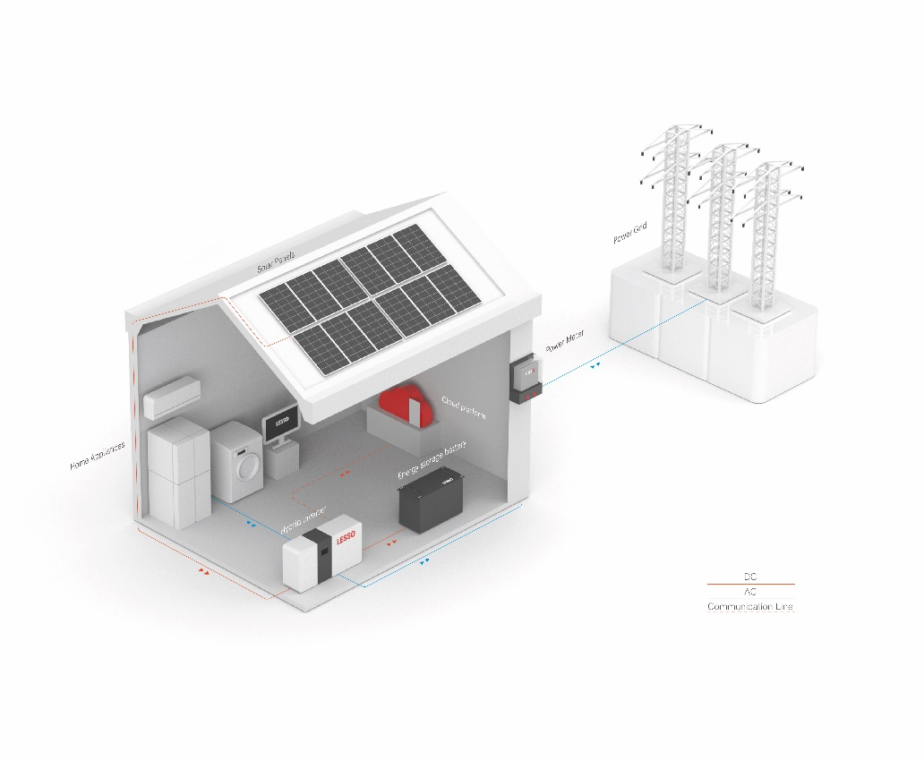
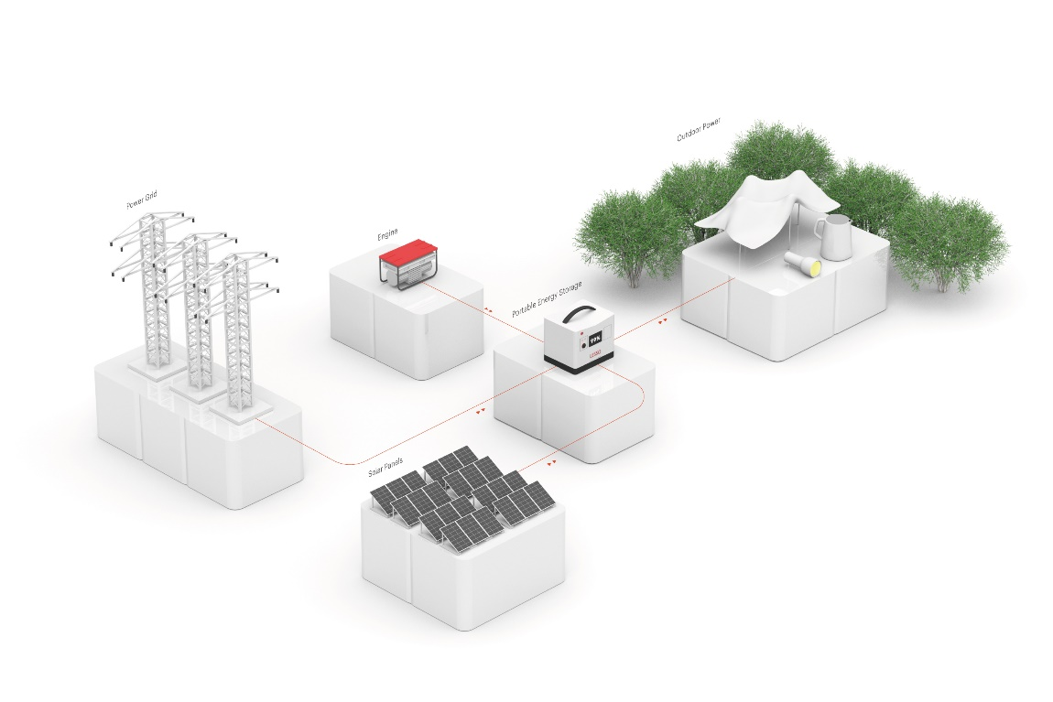
Portable Outdoor and Residential Solution

Slide 18
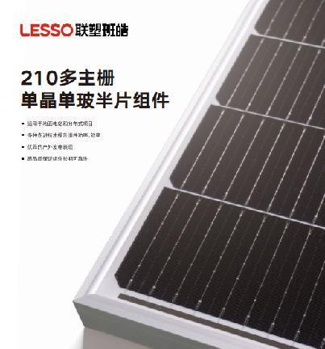
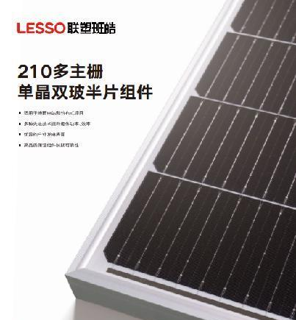
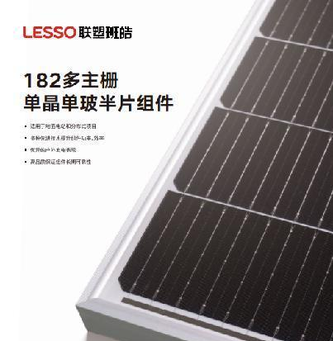
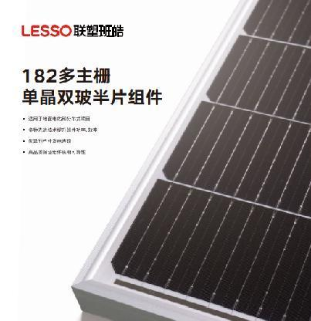
Solar Panel N-type and P-type
*Existing all black range
182 MBB
Mono-Perc Half-cell module
182 MBB Bi-facial
Half-cell module
210 MBB
Mono-Perc Half-cell module
210 MBB Bi-facial
Half-cell module
182 Cell Mono-Perc | 182 Cell Bifacial
Power Range
390W~550W | 395W~555W
Product workmanship warranty
12 Years | 12 Years
Linear power output warranty
25 Years | 30 Years
Power Degradation
1st Year: 2% Subsequent annual: 0.55% | 1st Year: 2% Subsequent annual: 0.45%
210 Cell Mono Perc | 210 Cell Bifacial
Power Range
525W~670W | 525W~670W
Product workmanship warranty
12 Years | 12 Years
Linear Power output warranty
25 Years | 30 Years
Power Degradation
1st Year: 2% Subsequent annual: 0.55% | 1st Year: 2% Subsequent annual: 0.45%
12 years product workmanship warranty
Power range：single glass 390w~550w、dual glass bicacial 395w~555w
182 cell mono panel,25 years linear power output warranty，
1st year power degradation no more than 2%.Subsequent annual power degradation no more than 0.55%
182 cell mono dual glass panel,1st year power degradationno more than 2%.Subsequent annual power degradation no more than 0.45%
12 years product workmanship warranty
Power range：single glass 525w~670w、dual glass bifacial 525w~670w
210 cell mono panel,25 years linear power output warranty，
1st year power degradation no more than 2%.Subsequent annual power degradation no more than 0.55%
210 cell mono dual glass panel,1st year power degradationno more than 2%.Subsequent annual power degradation no more than 0.45%

Slide 19
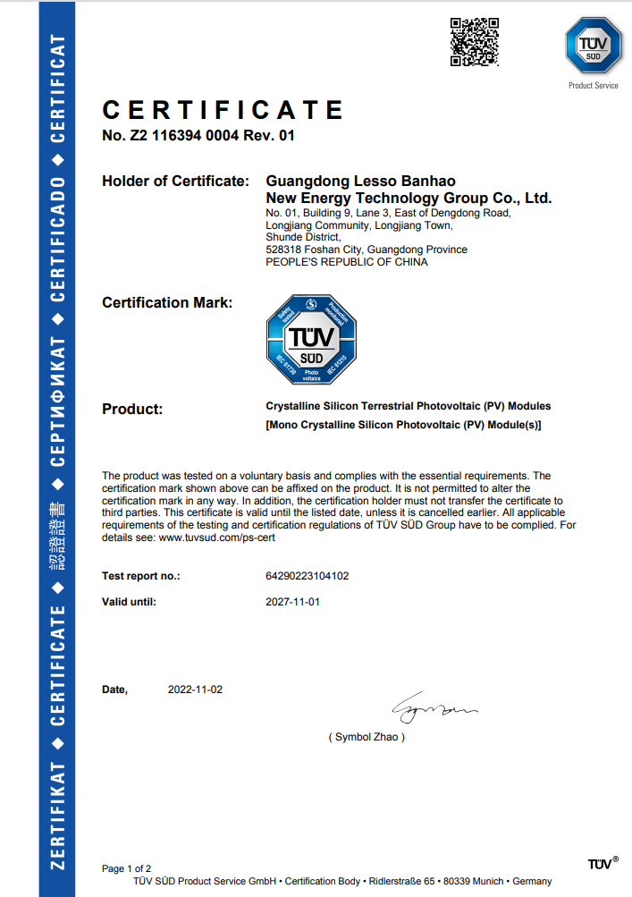
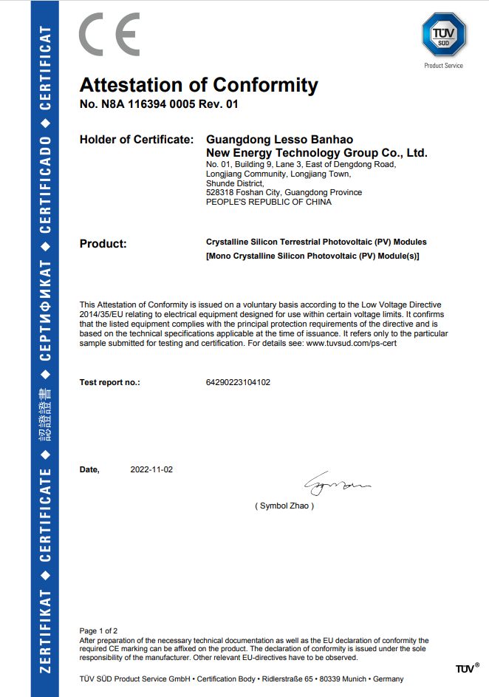

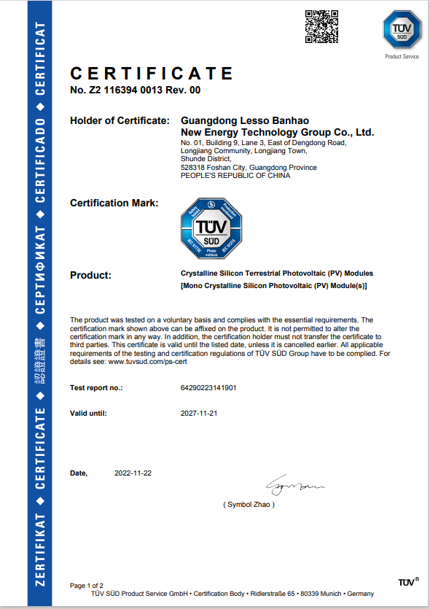
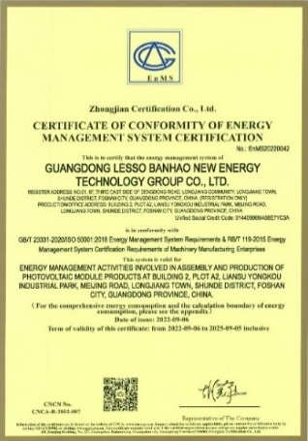
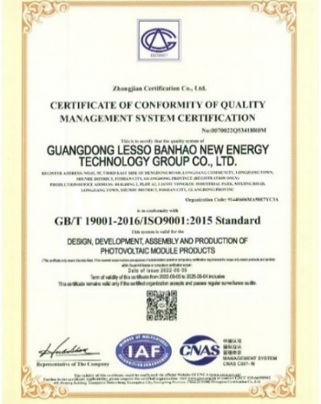
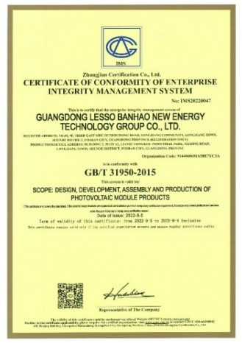
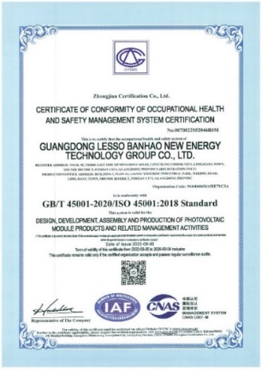
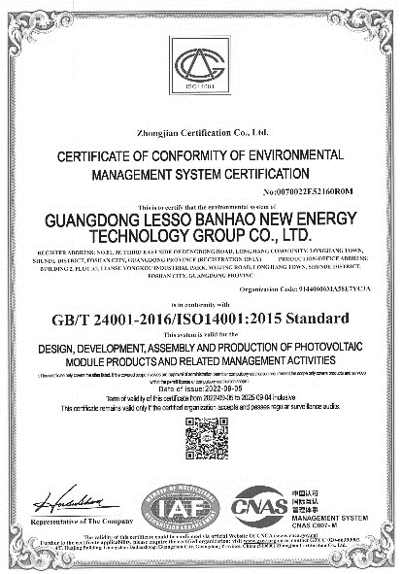
Certifications
（#182&210 MBB Mono Perc Single/Bifacial Half-cell Module）
Test certificates:
IEC61215 ,
IEC61730 ,
IEC TS 62782 ,
IEC 61701 , IEC62716 ,
IEC 60068-2-68 ,
PPP 58042 ,
PPP 58069 ,
CQC
EnMS
ISO9001
IMS
OHSMS
ISO14001

Slide 20
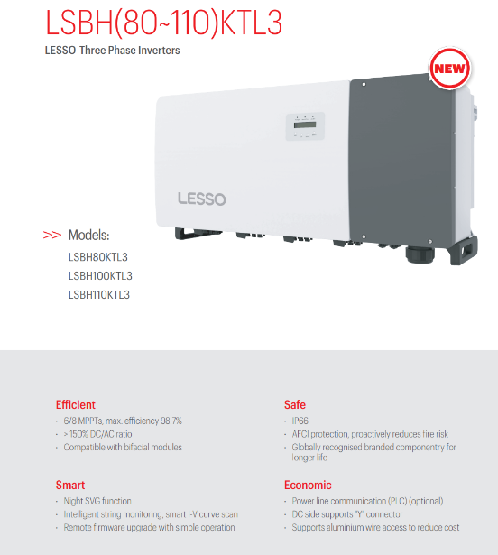
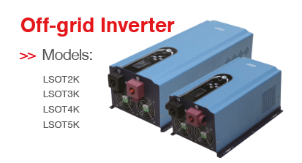
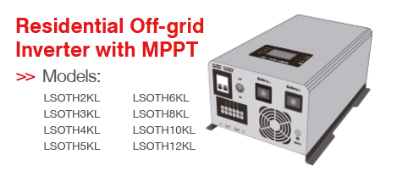
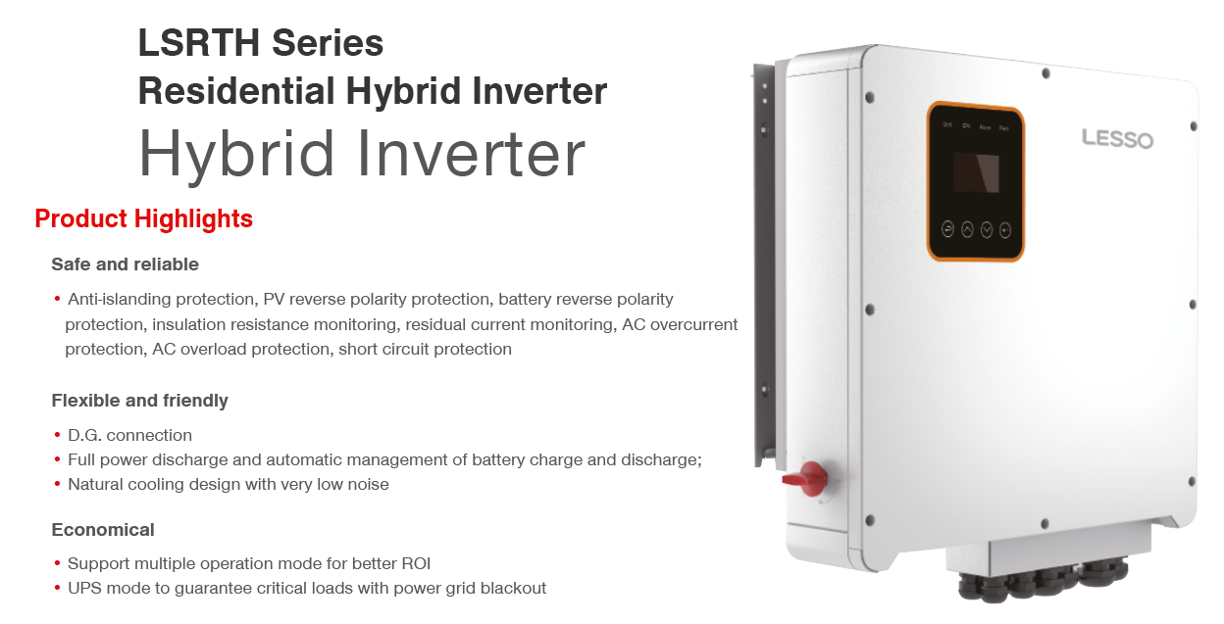
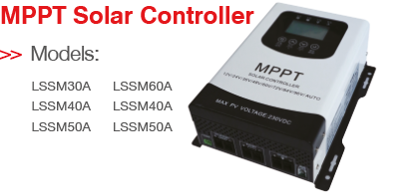
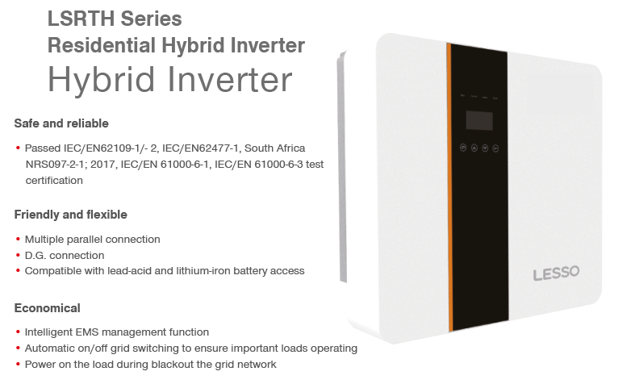
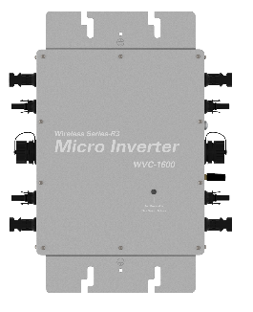
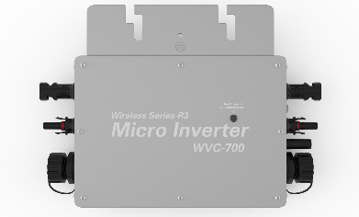
Inverter
Hybrid
Off-Grid
Micro inverter
WVC1600
WVC 700

Slide 21
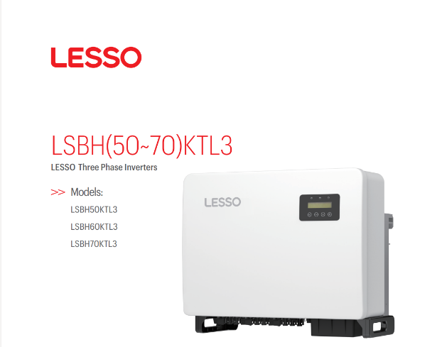
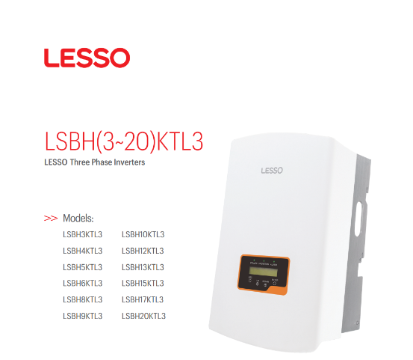
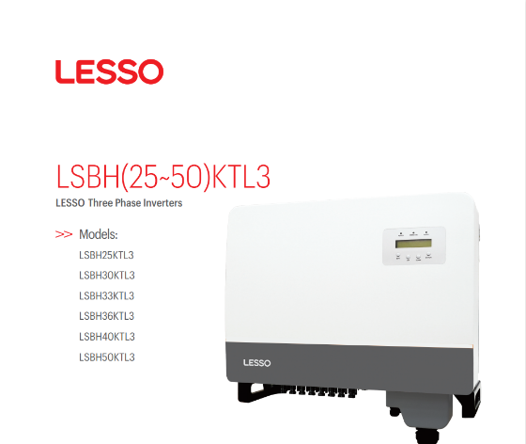
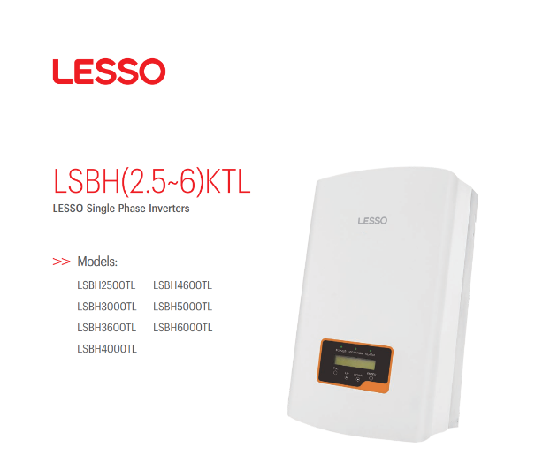
Inverter
Single-Phase Inverter

Slide 22
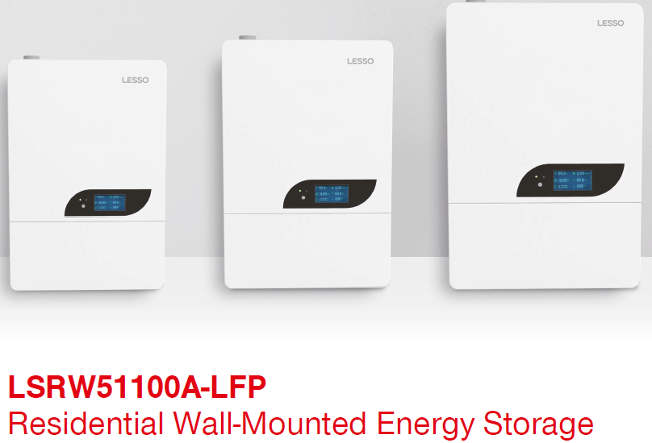
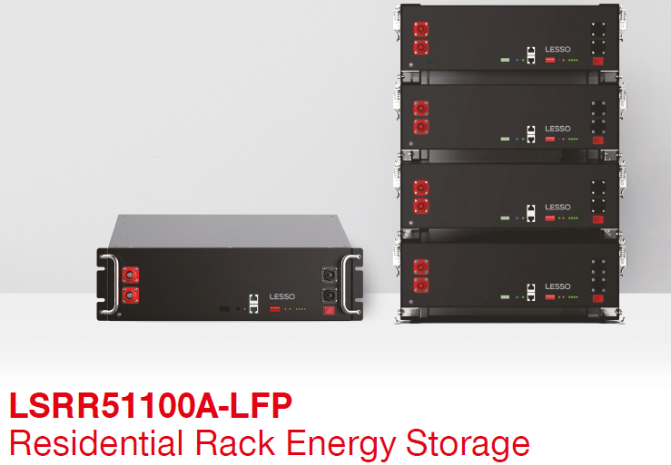




Residential Energy Storage

Slide 23



Portable PV module

Slide 24




Portable Energy Storage

Slide 25


Mounting System
Mounting System For Color Steel Tile Roof
Mounting System For Concrete Roof

Slide 26

Star Projects by LESSO

Slide 27







Overview of Star Projects
HN Shenyu Distributed Power Station
▪ Changsha, Hunan ▪ 340KW
Yingbao Distributed Power Station
▪ Shunde, Guangdong ▪ 500KW
Jiangling Miye Distributed Power Station
▪ Jingzhou, Hubei ▪ 1000KW
Chongkou Distributed Power Station
▪ Shunde, Guangdong ▪ 1700KW
By Dec 31 2022, LESSO has participated in the construction of
90 projects of PV power stations,
including 78 domestic projects and 12 overseas projects. LESSO owns 16 power stations, with an installed capacity of up to 12.5MW.
Huaihua Distributed Power Station
▪ Huaihua, Hunan ▪ 1164KW
Muling Distributed Power Station
▪ Mudanjiang, Heilongjiang ▪ 799KW

Slide 28


Case Examples
Karamay Mengshiruida Project
Location: Wuerhe District, Karamay, Xinjiang
Project Capacity: 200MWp
Storage Capacity: 40MW/80MWh
Module Type: LESSO 182 Mono-Bifacial - 545W [545D(HBD)72(182)]
AVIC Tongfei Distributed PV Power Project
Location: AVIC General Plant, Zhuhai, Guangdong Province
Project Capacity: 2675.16KW
Module Type: LESSO 182 Mono-facial - 540W [540D(HPM)72(182)]

Slide 29






More Photos
PANELS WITH HIGH EFFICIENCY AND MATERIALS WARRANTY
Notes:
Shunde Yingbao Building（Concrete Roof）
Completed and put into use by 2022
The power generation first year is around 516 thousand kWh, the average power generation is 474 thousand kWh per year. The gross generation is expected to reach 12 million kWh according to 25-year warranty.
Lesso Workshop（ Color steel tile roof ）
Completed and put into use by 2022
The power generation first year is around 1.7 million kWh, the average power generation is 1.5 million kWh per year. The gross generation is expected to reach 39 million kWh according to 25-year warranty.

Slide 30


Slide 31


LESSO NEW ENERGY DEVELOPMENT PRIVATE LIMITED

